Slide 1
BDD & SpeCFlow
Presenter
Mayukh Sinha (SDET 2)
Kushagra Kapoor (Team Lead SDET)

Slide 2
Agenda
1
Introduction to BDD, BDD Tools
2
Feature File, Step Definition File
3
NUnit, How to create SpecFlow project in .net
4
Hooks - Execution Order, Tag Scoping
5
Step Argument Transformation
6
Assist Helpers – CreateInstance, CreateSet
7
FeatureContext and ScenarioContext and context Injeciton
8
SpecFlow+Living Doc Generator

Slide 3


Introduction To BDD
Behavioral Driven Development (BDD) is a software development process, tests are more user-focused and based on the system’s behavior. It improves collaboration between tech and non-tech teams and stakeholders.
BDD Benefits:
Better communication between developers, testers, product owners, stake-holders.
Tests are very easy to understand, hence the learning curve is much shorter.
The behavioral approach defines acceptance criteria prior to development.
Reduce the scope of ambiguity.
SOTI Confidential - Only for use under NDA - Do not distribute

Slide 4


BDD Tools
Specflow is a testing framework which supports Behavior Driven Development (BDD). It lets us define application behavior in plain meaningful English text defined by a language called Gherkin.
Gherkin is a plain English text language, which helps the tool – Cucumber/SpecFlow to interpret and execute the test scripts. It can be written in 37+ spoken languages.

Slide 5
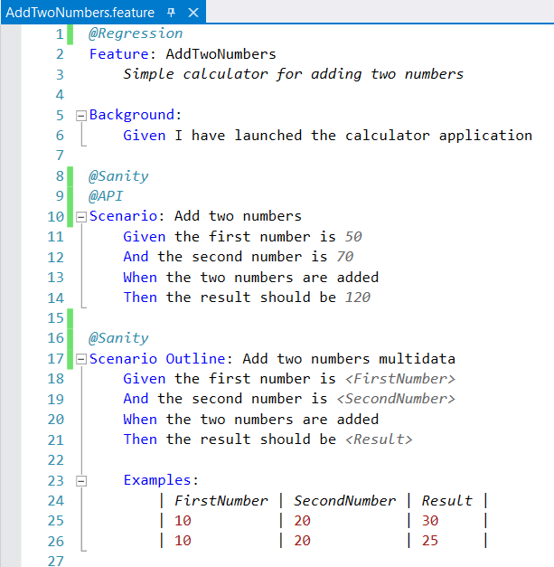
Feature File
The feature files used by SpecFlow to specify acceptance criteria for features in your application are defined using the Gherkin syntax.
Keywords used in feature file are:
Feature
Background
Scenario
Scenario Outline
Given
When
Then
Extension of the feature file is .feature

Slide 6
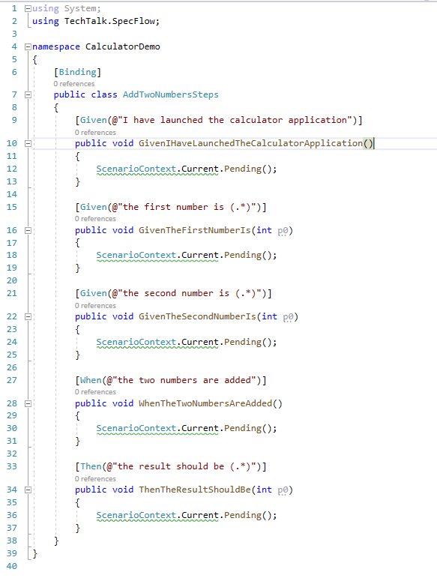
Step Definition File
In order to test the scenarios, we need to create step definitions which provide a connection between the feature files and the application code. SpecFlow provides a skeleton of the step code that can be extended further.
Step Definition Method Rules:
Must be a public class, marked with [Binding] attribute.
Methods must be public.

Slide 7
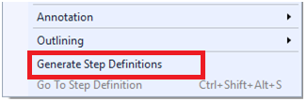
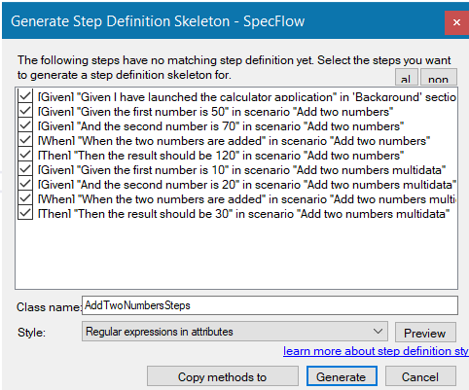
Step Definition File…Continued
How to generate Step Definition File:
Right click on your feature file in the code editor and select ‘Generate Step Definitions; from the popup menu.
Enter the name for the class.
Select the style.
Click on Generate and save the file.
A new step definition class is added to your project with steps for each of the steps in the scenario.

Slide 8
How SpecFlow Works
Specification
Binding
Application
Feature File
Step Definition Class
Application Class
Code Behind file generated by
SpecFlow at runtime
Calls

Slide 9

NUnit
Nunit is a “Unit-Testing” framework for all .net languages (C#, F#, Visual Basics).
In Unit testing, we break down the functionality of the application into discrete testable behaviours that we can test as individual units.
Nunit is an open-source software, released under the MIT license. This framework is very easy to work with and has user friendly attributes for working.

Slide 10
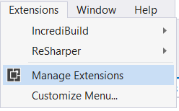
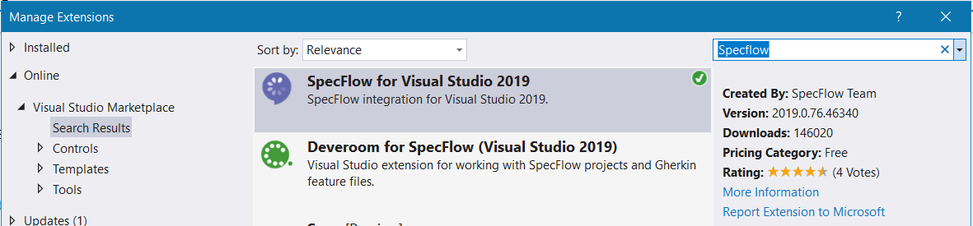
How to create a specflow project in .net
1. Install the SpecFlow Extension.
Open Visual Studio, Go to “Extension” > Manage Extensions > Search for “SpecFlow” in online section.
Note: It will ask you to close all running instances of Visual Studio to install the extension. And you need to restart the Visual Studio to finalize the installation.

Slide 11
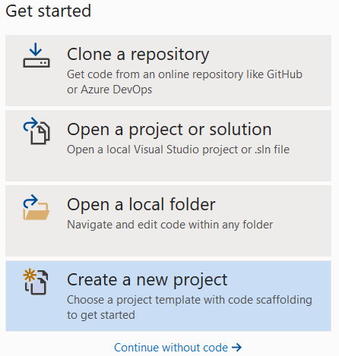
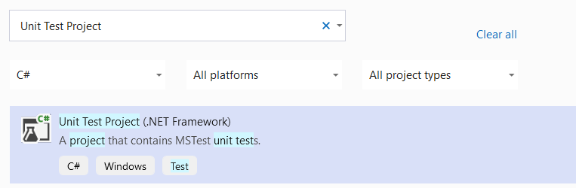
2. Open Visual Studio > click on “Create a new project” > Select “Unit Test Project” > click on “Next” button.

Slide 12
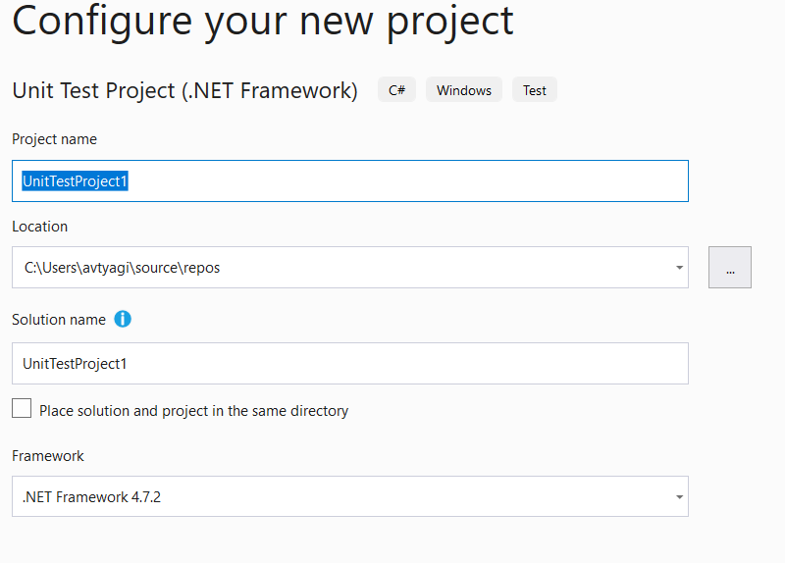
Provide the project details
Project Name
Location (Project Path)
Solution Name
Framework Type
And click on “Create” button.

Slide 13
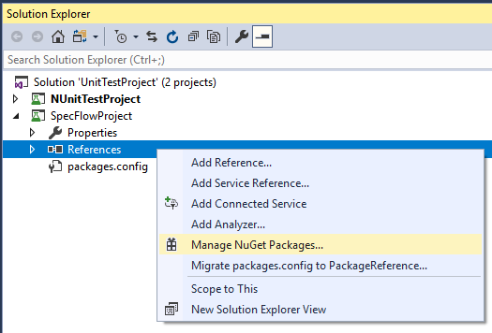
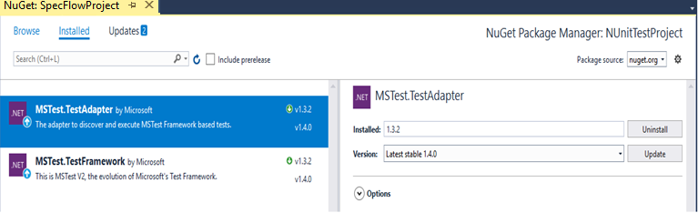
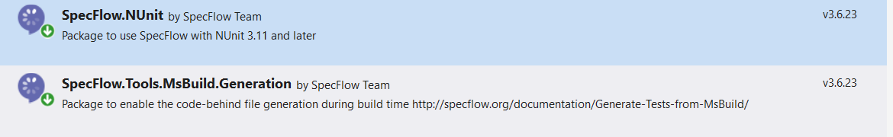
4. Remove pre-included “MSTest.TestFramework” and “MSTest.TestAdapter” nuget packages from the project.
5. Add “SpecFlow.Nunit” and “SpecFlow.Tools.MsBuild.Generation” nuget packages to the project.

Slide 14
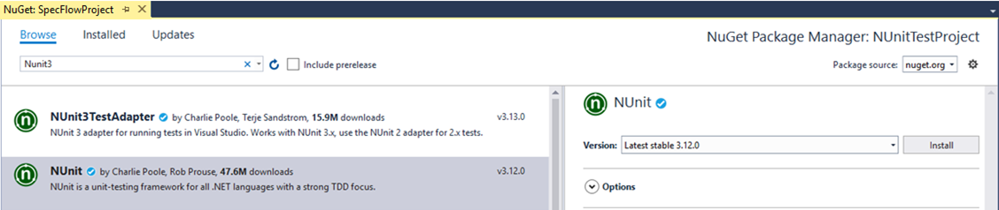
6. Add “NUnit3TestAdapter” and “Nunit” nuget packages to the project.

Slide 15
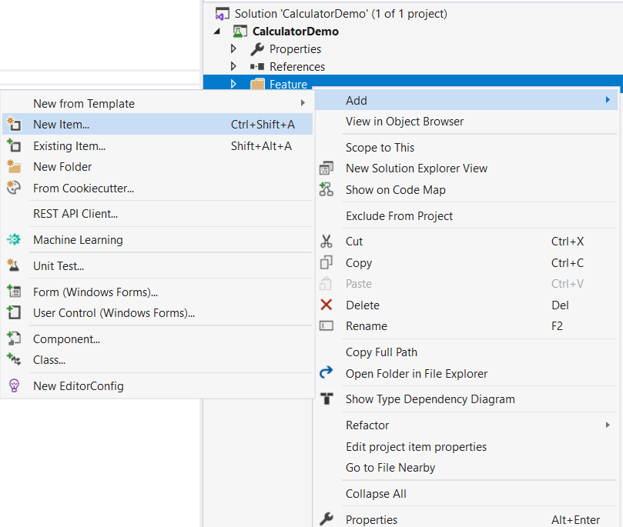
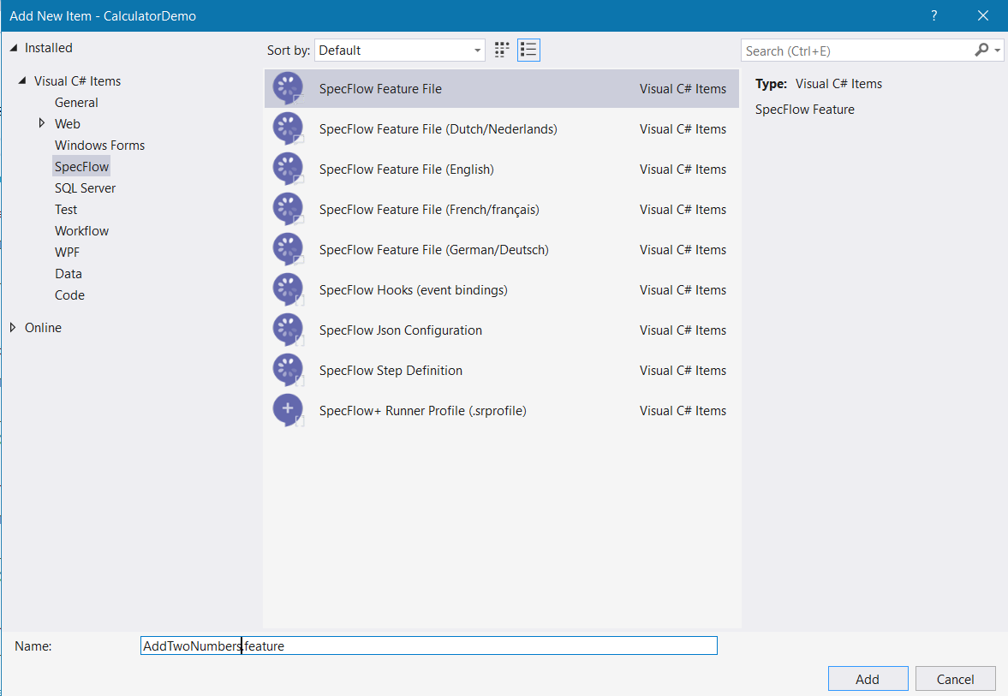
7. Add New Item i.e Feature File to the project.

Slide 16
Hooks
Hooks (event binding) can be used to perform additional automation logic at specific times, such as before executing a scenario.
In order to use hooks, you need to add the [Binding] attribute to your hooks class.
ATTRIBUTE | DESCRIPTION
[BeforeTestRun] [AfterTestRun] | Automation logic that must run before/after the entire test run
[BeforeFeature] [AfterFeature] | Automation logic that must run before/after executing each feature The method it is applied to must be static.
[BeforeScenario] or [Before] [AfterScenario] or [After] | Automation logic that must run before/after executing each scenario or scenario outline example
[BeforeScenarioBlock] [AfterScenarioBlock] | Automation logic that must run before/after executing each scenario block (e.g. between the "givens" and the "whens")
[BeforeStep] [AfterStep] | Automation logic that must run before/after executing each scenario step

Slide 17
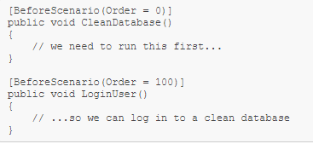
Hook Execution Order
By default, the hooks of the same type (e.g 2 [BeforeScenario] hook) are executed in an unpredictable order. If you need to ensure a specific execution order, you can specify the “Order” property in the hooks’ attribute.
The number indicates the order, not the priority, i.e the hook with lowest number is always executed first.
NOTE: If no order is specified, the default value is 1000.

Slide 18
Hook Tag Scoping
Most hooks support tag scoping. Use tag scoping to restrict hooks to only those scenarios that have the tag filter. You can specify the tag in the attribute.
e.g. [BeforeScenario(“scenarioTagName”)]
NOTE: BeforeTestRun and AfterTestRun are executed outside of the scenario and feature scope, so no scenario or feature associated tags are loaded at this point and we can not use tag scoping.

Slide 19
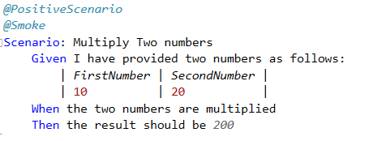
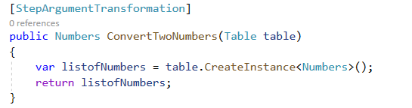
Step Argument Transformation
Step argument transformations can be used to apply a custom conversion step to the arguments in step definitions.
A step argument transformation is used to convert an argument if:
The return type of the transformation is the same as the parameter type.
The regular expression (if specified) matches the original (string) argument.

Slide 20
Assist Helpers
Table plays important role in SpecFlow scenarios, we can pass multiple parameters in tabular form that are more complex than a single value.
To work with tables, SpecFlow provides TechTalk.SpecFlow.Assist namespace.
Methods provided by TechTalk.SpecFlow.Assist:
CreateInstance.
CreateSet
CompareToInstance
CompareToSet

Slide 21
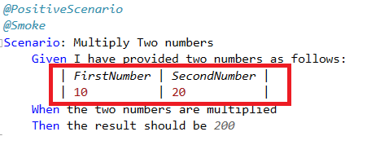
Assist Helpers…Continued
CreateInstance<T>
CreateInstance<T> is an extension method of Table that will convert the table data to an object.
For example, if you list data in a table that lists the values of your object like this:

Slide 22
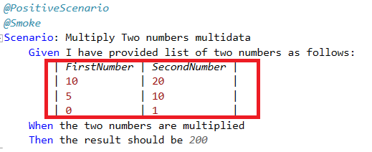
Assist Helpers…Continued
CreateSet<T>
CreateSet<T> is an extension method of Table that will convert the table data into a set of objects.
For example, if you list data in a table that lists the values of multiple objects like this:

Slide 23
FeatureContext
SpecFlow provides access to the current test context using both FeatureContext and the more commonly used ScenarioContext.
FeatureContext persists for the duration of the execution of an entire feature, whereas ScenarioContext only persists for the duration of a scenario.
FeatureContext.FeatureInfo
FeatureInfo provides information like
Title
Description
Tags
Target Language
Language

Slide 24
ScenarioContext
The ScenarioContext is created for each individual scenario execution and it is disposed when the scenario execution has been finished.
ScenarioContext.ScenarioInfo
ScenarioInfo provides information like
Description
Tags
ScenarioContext.Current
The ScenarioContext.Current instance can be used as a property bag to store and retrieve data.
It helps you store values in a dictionary between steps. This helps you to organize your step definitions better than using private variables in step definition classes

Slide 25
CONTEXT INJECTION
SpecFlow supports a very simple dependency framework that is able to instantiate and inject class instances for scenarios. This feature allows you to group the shared state in context classes, and inject them into every binding class that needs access to that shared state.
To use context injection:
Create your POCOs (simple .NET classes) representing the shared data.
Define them as constructor parameters in every binding class that requires them.
Save the constructor argument to instance fields, so you can use them in the step definitions.

Slide 26
SpecFlow+Living Doc Generator
It is a set of plugins and tools for SpecFlow to generate a local or self-hosted documentation out of the Gherkin feature files, which can be easily shared within the team and stakeholders without the need of Visual Studio.
Benefits:
Results can be shared and viewed easily without the need of Visual Studio.
Faster feedback can be provided.
Features:
Powerful searching and filtering
Preview scenarios with test values

Slide 27
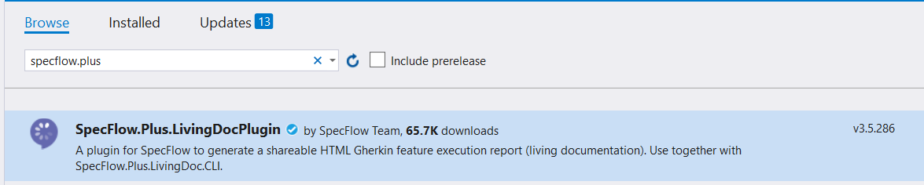
How to generate the Living Doc?
Install the “SpecFlow.Plus.LivingDocPlugin: nuget in your project.
Note: It requires SpecFlow version >=3.4.3 <=3.5.286

Slide 28
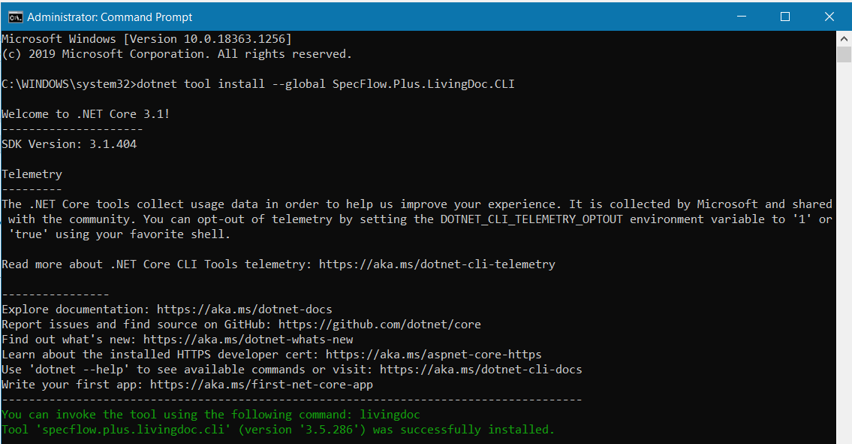
Install the “SpecFlow+LivingDoc CLI” by executing below command.
“dotnet tool install --global SpecFlow.Plus.LivingDoc.CLI”
Note: It requires at least .net core sdk 3.1

Slide 29
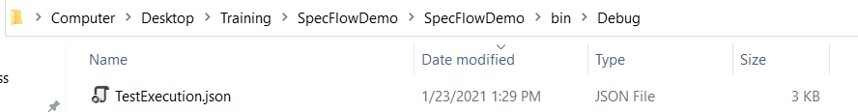
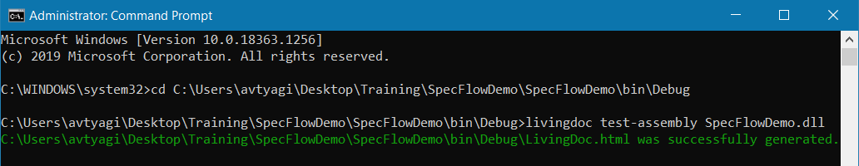
3. Run the test, after test execution completes, anew “TestExecution.json” file will be created in the output directory of the project.
4. Run the command “livingdoc test-assembly <PathToTestAssembly>” in command line.

Slide 30
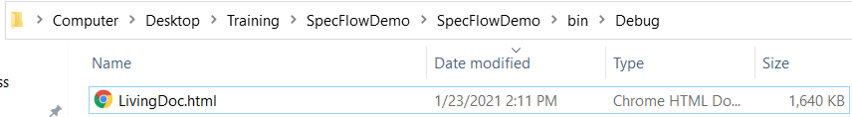
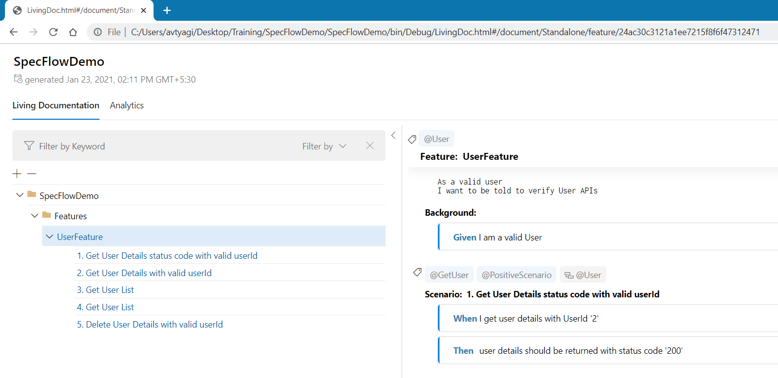
5. A new “LivingDoc.html” will be created in the same folder.

Slide 31


Questions?
SOTI Confidential - Only for use under NDA - Do not distribute

Slide 32



Thank you
soti.net
© 2020, SOTI Inc. All Rights Reserved

